Slide 1
NEXT-GENERATION CHALLENGES IN BIOINFORMATICS
Graziano PESOLE
Università di Bari & IBBE-CNR, Bari, Italy
Palermo 9-12 Settembre 2014

Slide 2
The birth of Bioinformatics
PCR
1985
Roche 454
2004
1953
DNA structure
1977
Maxam & Gilbert
Sanger
sequencing methods
1986
AB Sequencer
1995
First genome of a free-living organism
2001 Human Genome

Slide 3
Maxam & Gilbert Sequencing
G
A+G
T+C
C
Base-specific modifications
G DMS pH 8
A+G pH 2
T+C Hydrazine
C Hydrazyne NaCl 1.5 M
Cut by piperidine
The DNA fragments which differ by one nucleotide are denatured by heat and separated by gel electrophoresis in the presence of 8M urea, a denaturing agent that prevents the formation of intra-chain pairings.
The residues of A are identified by comparing the positions G-only cuts with those of A+G-cuts, and analogously T residues are identified by comparing the positions C-only cuts with those of T+C-cuts.

Slide 4
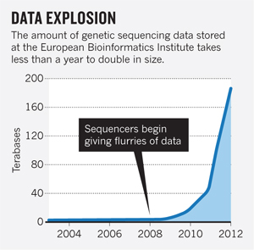
Sequencing data explosion

Slide 5
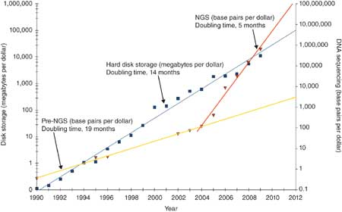
Sequencing data growth and costs: Big Data in Biology

Slide 6
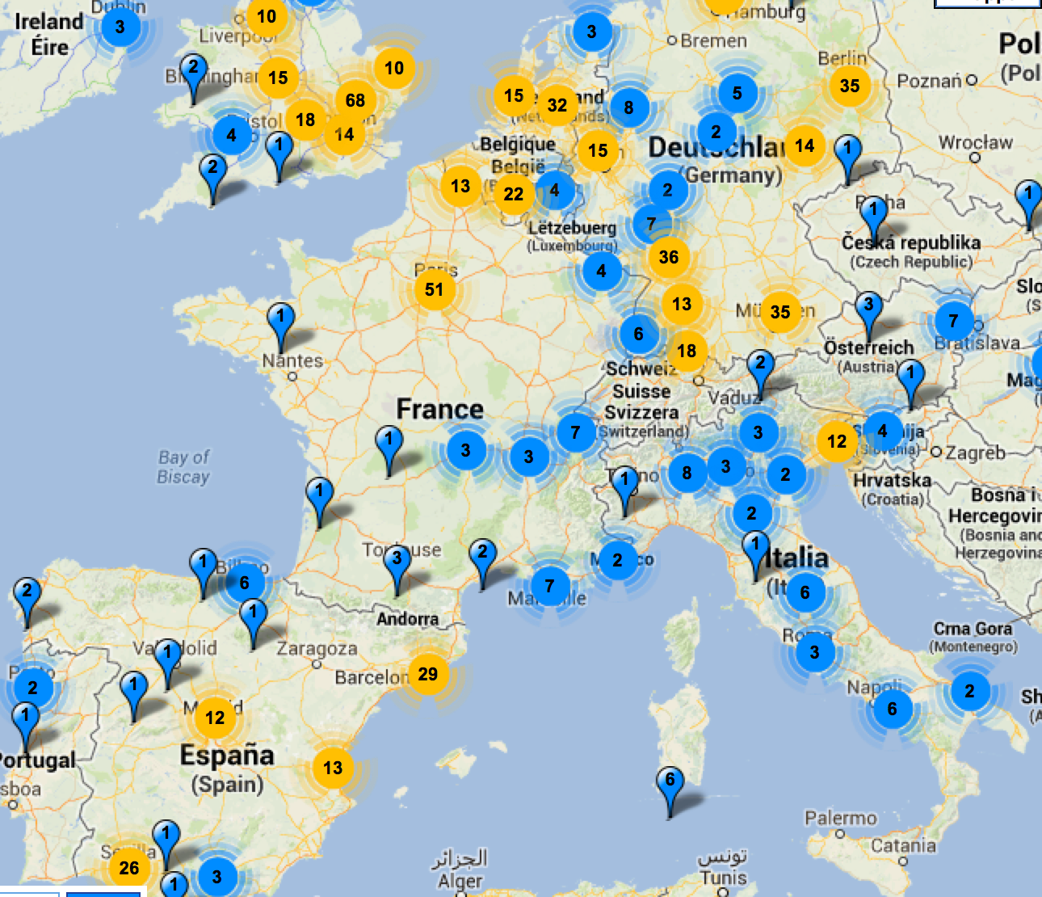
Worldwide distribution of NGS platforms
>2558 total machines (>1000 US, >300 China, .., >50 Italy)
Source: omicsmap.com
Notes:
The very rapid and widespread success of exome sequencing in the study of human disease is due to varous factors. First, NGS platforms become rapidly available to many researcher directly or indirectly through service providers. People have invested a lot of money in this technology, and they are interested to keep the instrument running!
Illumina GA2&HiSeq, Miseq, SOLID, Proton and Ion torrent, 454, PacBio, Polonator

Slide 7
Challenges
1
Technology (Storage, Retrieval, Computation, Networking)
2
Science (Data integration, Analysis, Statistical evaluation)

Slide 8
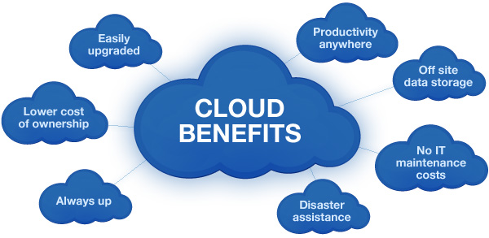
Technology challenges

Slide 9
Technology challenges
Reference databases
NGS data
Software Tools
Moving tools instead than data may be faster and more effective.

Slide 10
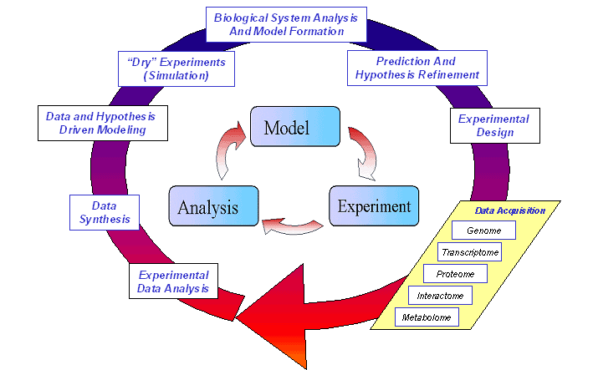
Experimental challenges

Slide 11
Experimental challenges
1
Experimental data analysis
State of the art methods for data analysis are still not fully satisfactory and different methodologies generally produce only partially overlapping results (e.g. RNA-Seq data analysis for mRNA isoform detection and quantification, characterization of the methylation pattern by BS-Seq, etc.).

Slide 12
Experimental challenges
2
Data and results integration
A relevant breakthrough in understanding molecular mechanisms can be obtained integrating data form different sources (e.g. correlating epigenetic marks and expression profiles, etc.). A few tools are so far available and therefore efforts in this direction are highly needed.

Slide 13
Experimental challenges
3
Model design and validation
The ensemble of data and their specific inter-correlations should make possible the design of specific models that should be reliably validated. Some efforts in this direction are in progress (e.g. virtual cell models, http://www.nrcam.uchc.edu/) but they are generally nice exercises without relevant “practical” outcomes.
This is the real new frontier of modern biology.

Slide 14
Dimensioni dei Genomi Eucariotici
plasmids
viruses
bacteria
fungi
plants
algae
insects
mollusks
bony fish
amphibians
Il Genoma umano è costituito da circa 3 miliardi di bp e contiene un numero di geni (ancora imprecisato) pari a circa 25,000.
reptiles
birds
mammals
10⁴
10⁵
10⁶
10⁷
10⁸
10⁹
10¹⁰
10¹¹

Slide 15
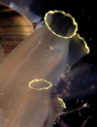
Assenza di correlazione tra numero di geni e dimensione del genoma negli eucarioti
Number of genes in prokaryotes (up to 8000)
Genome size in prokaryotes (up to 9 Mb)

Slide 16
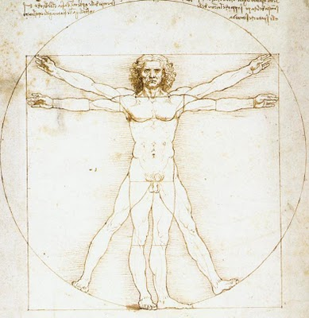
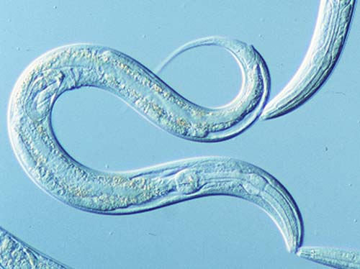
Assenza di correlazione tra numero di geni e complessità organismica
20.000 geni
10³ cellule
20.000 geni
10¹³ cellule

Slide 17
La porzione non codificante dei genomi eucariotici
4.7 Mb
12.1 Mb
100 Mb
3000 Mb
L’annotazione funzionale delle porzioni non-codificanti del genoma è una delle sfide principali dell’era post-genomica.

Slide 18
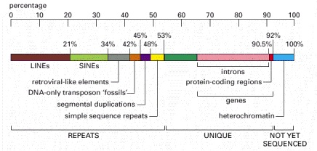
Genoma nucleare umano
(Nature, 431: 931-945, 2005)
(da: Molecular Biololgy of the Cell, Fig. 4.17)
La porzione codificante rappresenta l’1-2% del genoma (geni codificanti per proteine, tRNA e rRNA.
La porzione non-codificante è costituita da sequenze uniche e sequenze ripetute. Queste si suddividono in: 1) ripetizioni intersperse LINEs, SINEs, LTR, trasposoni a DNA); e 2) ripetizioni in tandem (blocchi ripetuti in tandem dei centromeri e dei telomeri, micro- e mini-microsatelliti, duplicazioni segmentali).
La distribuzione degli elementi ripetuti varia trai i cromosomi, con alcuni cromosomi che contengono anche il 90% di DNA non codificante
Notes:
Figure 4-17
. Representation of the nucleotide sequence content of the human genome
LINES, SINES, retroviral-like elements, and DNA-only transposons are all mobile genetic elements that have multiplied in our genome by replicating themselves and inserting the new copies in different positions. Mobile genetic elements are discussed in Chapter 5. Simple sequence repeats are short nucleotide sequences (less than 14 nucleotide pairs) that are repeated again and again for long stretches. Segmental duplications are large blocks of the genome (1000–200,000 nucleotide pairs) that are present at two or more locations in the genome. Over half of the unique sequence consists of genes and the remainder is probably regulatory DNA. Most of the DNA present in heterochromatin, a specialized type of chromatin (discussed later in this chapter) that contains relatively few genes, has not yet been sequenced. (Adapted from Unveiling the Human Genome, Supplement to the Wellcome Trust Newsletter. London: Wellcome Trust, February 2001.)

Slide 19
Che cosa è un GENE
L’avvento dell’era genomica ha messo in crisi la tradizionale definizione di GENE, tuttora molto dibattuta.
Lewin B. Il Gene VIII
Segmento di DNA coinvolto nella produzione di una catena polipeptidica, comprende regioni (leader e coda) che precedono e seguono la regione codificante, oltre alle sequenze intercalate (introni) tra i singoli elementi codificanti (esoni).
Brown T.A. Genomi 2
Un segmento di DNA contenente informazioni biologiche, che codifica per una molecola di RNA e/o proteina.
Ambedue queste definizioni non possono essere considerate corrette alla luce delle attuali conoscenze.
Ovviamente, se non ci si accorda sulla definizione di gene, non è possibile determinarne il numero, anche assumendo di disporre della annotazione completa del genoma.

Slide 20
Definizione di GENE
Per giungere ad una definizione il più possibile corretta di GENE è necessario conoscerne le caratteristiche principali.
Un gene può utilizzare diversi promotori
La trascrizione di un gene si può arrestare in corrispondenza di diversi terminatori
I trascritti espressi da un gene possono subire splicing alternativo che generano trascritti che differiscono sia nelle regioni non tradotte (5’ e 3’UTR) che nella regione codificante
Il gene per tp73L codifica per 10 trascritti alternativi, e utilizza 2 promotori e 3 diversi terminatori della trascrizione (predizione ottenuta dal programma ASPIC).

Slide 21
10’
γ
β
P1
P2
TAp63
∆Np63
(A)
1
2
3
3’
4
5
6
7
8
9
10
11
12
13
14
α
(B)
Human TAp63α  _003722; 14 exons; 680 aa
Mouse TAp63α  _001127259; 14 exons; 680 aa
Human TAp63β  _001114978; 13 exons; 555 aa
Mouse TAp63β  _001127260; 13 exons; 555 aa
Human TAp63γ  _001114979; 11 exons; 487 aa
Mouse TAp63γ  _001127261; 11 exons; 483 aa
Human ΔNp63α  _001114980; 12 exons; 586 aa
Mouse ΔNp63α  _011641; 12 exons; 586 aa
Human ΔNp63β  _001114981; 11 exons; 461 aa
Mouse ΔNp63β  _001127262; 11 exons; 461 aa
Human ΔNp63γ  _001114982; 9 exons; 393 aa
Mouse ΔNp63γ  _001127263; 9 exons; 393 aa

Slide 22
I geni possono essere sovrapposti
I geni possono essere sovrapposti tra loro, nello stesso orientamento o in orientamento opposto, o anche essere completamente contenuti in altri geni.
L’introne 26 del gene neurofibromatosis type I (NF1) contiene 3 geni diversi nell’orientamento opposto (OMGP, EVI2A, EVI2B).
vedi: http://posnania.biotec.psu.edu/research/overlapping_genes.html

Slide 23
Uno stesso gene può esprimere proteine con funzioni opposte: l’esempio dell’attività della Caspasi 9 (CASP9)
La forma costitutiva della proteina (CASP9, 9 esoni, 416 aa) induce apoptosi. Essa contiene un Caspase recruitment domain (CARD) e un dominio caspasi Peptidase_C14.
L’isoforma più corta della proteina (CASP9S, 5 esoni, 266 aa) contiene un dominio Caspase recruitment domain (CARD) e un dominio tronco della Peptidase_C14. Questa isoforma è priva dell’attività proteasica e agisce da inibitore dell’apoptosi.

Slide 24
Uno stesso gene può codificare per proteine indirizzate a diversi compartimenti cellulari: l’esempio del gene NFS1
La proteina codificata dal gene NFS1 fornisce zolfo inorganico ai cluster ferro-zolfo rimuovendo lo zolfo dalla cisteina, e formando alanina nel processo. Questo gene utilizza siti di inizio alternativi della traduzione per generare una isoforma mitocondriale ed una isoforma citoplasmatica. La selezione del sito di inizio della traduzione è regolata dal pH citosolico.
L’isoforma che codifica per la proteina mitocondriale (457 aa) contiene un peptide segnale e un dominio aminotrasnferasico.
L’altra isoforma, che deriva sa un sito di inizio alternativo della trascrizione codifica per una proteina più corta (397 aa) priva del peptide segnale ma contenente il dominio aminotransferasico.

Slide 25
Uno stesso gene può codificare trascritti soggetti ad un diverso meccanismo di regolazione post-trascrizionale: l’esempio di SLC11A2 expression
Il gene SLC11A2 (divalent cation transporter) codifica per (almeno) due diverse isoforme, solo una delle quali risponde alla concentrazione del ferro (i.e. i livelli della proteina aumentano sensibilmente in seguito alla carenza di ferro). Responsabile del mecanismo di regolazione è un “Iron Responsive Element (IRE)” nella regione 3’UTR presente solo in una delle due isoforme.
IRE
Nell’uomo il trascritto contenente l’IRE (16 exons) codifica per una proteina di 561 aa (NM_000617). Il trascritto privo di IRE (17 exons) non è presente nella banca RefSeq e codifica per una proteina di 568 aa.
IRE
La stessa situazione si verifica nel topo, per cui l’unica entry RefSeq corripsonde alla isoforma priva di IRE (NM_008732). Il meccanismo di risposta al ferro appare specifico del tipo cellulare.

Slide 26
Definizione di GENE
Nuova definizione:
Una specifica regione di DNA, la cui trascrizione è regolata da uno o più promotori e altri elementi di controllo trascrizionale che contiene l’informazione per la sintesi di proteine e RNA non codificanti funzionali, tra loro correlati per la condivisione di informazione genetica (con un tratto di sequenza genomica in comune) a livello dei prodotti finali (proteine o ncRNA).
In questo modo è possibile associare al gene specifiche coordinate genomiche che coincidono con il sito di inizio della trascrizione più a monte e il sito di terminazione più a valle.
Gene

Slide 27
Una nuova definizione operativa di gene
A
C
DNA
A
B
C
A
C
Due trascritti, un gene: i prodotti funzionali finali si sovrappongono a livello genomico. I due trascritti sono “geneticamente correlati” in quanto una mutazione nella regione di sovrapposizione avrebbe effetti su entrambi.
Al fine di valutare se due trascritti sono geneticamente correlati è necessario conoscere la localizzazione della regione codificante. In alternativa, questa può essere predetta attraverso una serie di approcci bioinformatici.

Slide 28
Una nuova definizione operativa di gene
DNA
A
B
C
H
Due trascritti, due geni: i prodotti funzionali finali non si sovrappongono a livello genico, mentre si osserva sovrapposizione a livello delle regioni 5’UTR. I due trascritti non sono “geneticamente correlati” in quanto nessuna mutazione può avere effetto su entrambi i prodotti finali. Una mutazione localizzata nella regione 5’UTR può modulare il livello di espressione di un gene, esattamente come una mutazione a livello di un promotore o di una regione enhancer.
See: Denoeud et al., Prominent use of distal 5' transcription start sites and discovery of a large number of additional exons in ENCODE regions, GENOME RESEARCH (2007)
.. “ Our results also suggest that genes are using the promoter(s) of other neighboring genes in specific cells and developmental stages, … Consistently, we observe that 6.2% (46/738) of the new 5’ends .. are shared by several genes, a proportion very likely to be underestimated..”

Slide 29
10-fold expansion of human transcriptome and proteome
We estimated that each gene - on average - generates about 12 different transcripts and 9 different proteins (90% in frame with the RefSeq protein). This implies “one order of magnitude expansion” of the human transcriptome and proteome (20,000 - 25,000 genes ⇒  250,000 proteins). Furthermore, our estimate may likely be an “underestimate” of the whole transcriptome/proteome complexity.
These data have been confirmed by Pan et al. (2008) and Wang et al. (2008) through a deep RNAseq survey.

Slide 30
Orthologous genes and the quest for functionally equivalent splicing variants
The same gene may encode structurally and functionally different transcripts and proteins through alternative splicing and alternative initiation and termination of transcription. This poses the urgent need of a revision and extension of the current definition of gene orthology.
In consideration that the gene exon-intron structure is highly conserved during evolution we assume that splicing variants sharing an identical or nearly identical exon-intron structure likely encode functionally equivalent products.
In this way, based on the pairwise similarity of the exon-intron structure measured by comparing the set of alternative transcripts derived from two orthologous genes (in two different species) we can easily detect pairs of structurally equivalent isoforms, we denote iso-orthologous, likely endowed of the same functional activity. The identification of iso-orthologous transcript is crucial when dealing with model organisms.

Slide 31
Iso-orthologous p63 variants
(A)
(B)
Isoform | Human | Mouse
TAp63 α | NM_003722 (14 exons; 680 aa) | NM_001127259 (14 exons; 680 aa)
TAp63 β | NM_001114978 (13 exons; 555 aa) | NM_001127260 (13 exons; 555 aa)
TAp63 γ | NM_001114979 (11 exons; 487 aa) | NM_001127261 (11 exons; 483 aa)
ΔNp63 α | NM_001114980 (12 exons; 586 aa) | NM_011641 (12 exons; 586 aa)
ΔNp63 β | NM_001114981 (11 exons; 461 aa) | NM_001127262 (11 exons; 461 aa)
ΔNp63 γ | NM_001114982 (9 exons; 393 aa) | NM_001127263 (9 exons; 393 aa)
ΔNp63 ε | GQ202689 (8 exons; 356 aa) | ?
ΔNp63 δ | GQ202690 (10 exons; 416 aa) | ?

Slide 32
Detection of Iso-orthologous variants
It is clearly evident that orthology relationships simply based on reciprocal best hits, may produce misleading results if structurally different isofoms are compared from two or more organisms (e.g TA and ΔN isoforms for human and mouse, respectively).
Therefore, to reliably establish orthology relationships it is fundamental to take into account non only sequence similarity, but also the evidence of a conserved exon-intron structure, bearing in mind that not all splicing isoforms are known for the organisms under investigation and that some isoforms may be species-specific.
The correct identification of structurally equivalent “orthologous isoforms” or iso-orthologous is an important factor to take into account in comparative studies, phylogenetic analyses, as well as in functional genomics analyses carried out on model organisms.

Slide 33
Detection of Iso-orthologous variants
ZMYND11
PHD
Bromo
PWWP
MYND
Human: NM_006624
(Mouse: a5923ed871:15)
135
160
162
78
93
Mouse: NM_144516
135
162
78
93
HTRA3
PDZ
Kazal-2
Trypsin
Human: NM_053044
(Mouse: NM_030127)
33
115
49
96
1133
Human: a37c4f0880:7
(Mouse: NM_001042615)
33
115
706
RAB15
RAS
Human: NM_198686
61
61
209
90
66
Mouse: NM_134050
(Human: d47ccf3a53:7)
61
61
78
90
66

Slide 34
Assessment of orthologous splicing isoforms in human and mouse orthologous genes
We have performed a large-scale human-mouse gene comparison to assess orthologous splicing isoforms. We observed an identical exon/intron structure for 32% of human and mouse orthologous genes (ISO1). This figure increased to 87% using less stringent criteria for gene structure similarity (ISO2 and ISO3). For about 13% of human annotated genes (and about 25% of the corresponding annotated transcripts) we could not identify any mouse transcripts showing sufficient similarity to be assigned as a splicing ortholog.
Zambelli F, Pavesi G, Gissi C, Horner DS, Pesole G. Assessment of orthologous splicing isoforms in human and mouse orthologous genes. BMC Genomics. 2010 Oct 1;11:534.

Slide 35
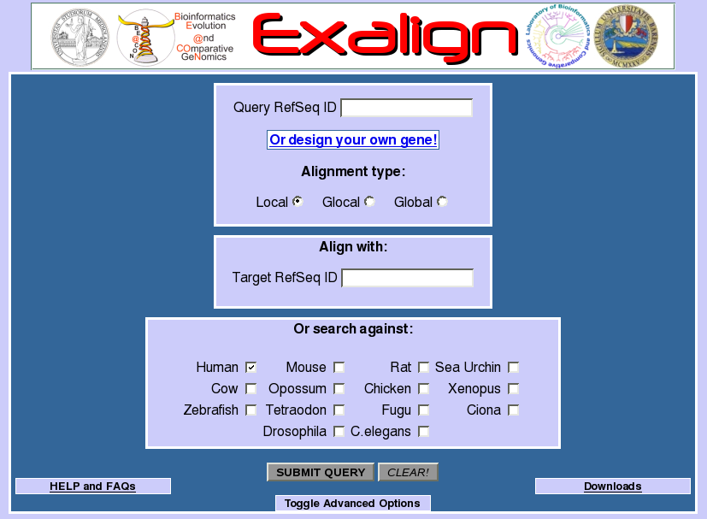

Slide 36
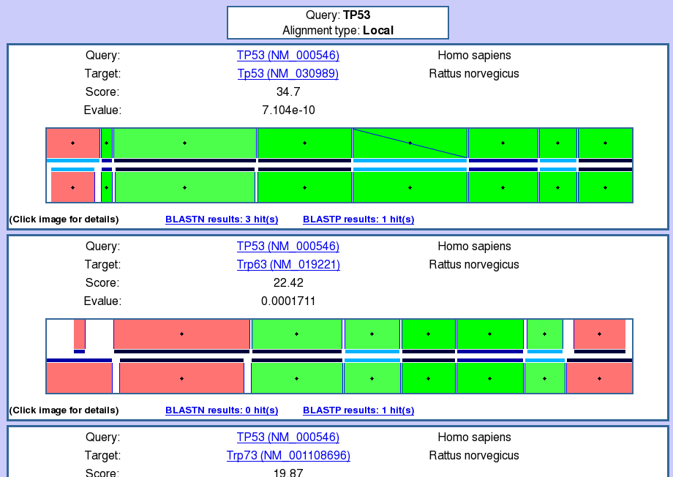

Slide 37
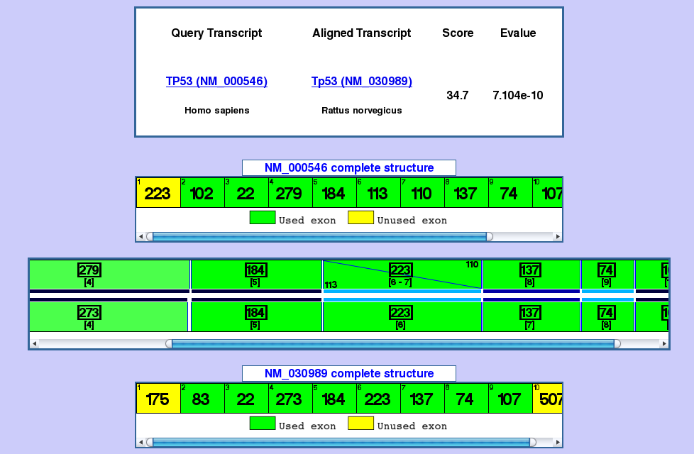

Slide 38
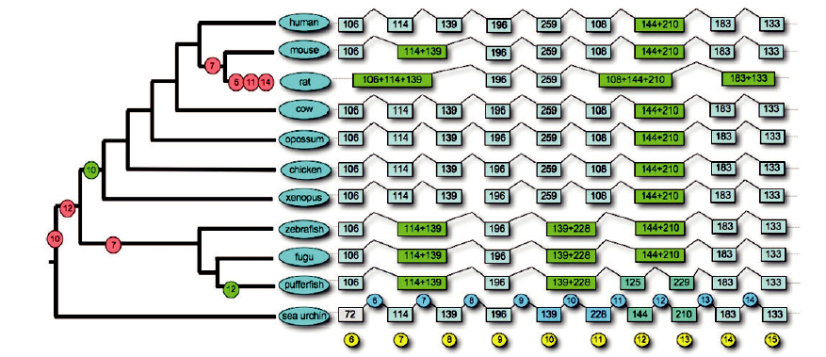
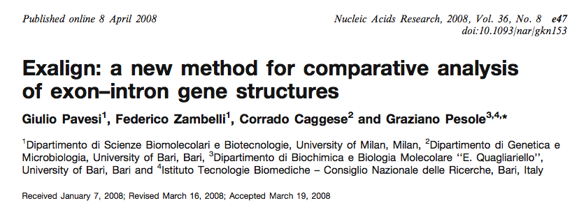
Application Example: evolutionary history of EEF2 orthologs

Slide 39
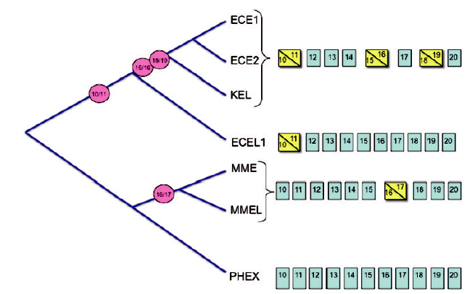
Application Example: human MET13 family members history

Slide 40
Conclusions
The gene concept needs to be drastically revised
one gene ➔ many transcripts (coding and non coding) ➔ many proteins or other ncRNAs
products of the same gene may have different, often antagonist functions
some genes/proteins may be species-specific, and in any case be careful in considering iso-orthologous transcripts to assess gene function in model organisms

Slide 41
Computational Challeges
1
Priotirization of disease-related mutations
2
Identification of pathogenic determinants in bacterial genomes and metagenomes
2
Identification and quantification of alternative splicing isoforms of protein coding and non coding RNA transcripts

Slide 42
ELIXIR: European Life Science Infrastructure for Biological Information
The data explosion in biomolecular data requires adequate IT infrastructures for data storage and analysis. The mission of ELIXIR is building a sustainable European infrastructure for biological information, supporting life science research and its translation to medicine, agriculture, bioindustries and society.
The challenge that biomolecular data resources face today is two-fold. Firstly, new technologies such as next-generation DNA sequencing are generating massive amounts of data. It has been estimated that between today and 2020 these new technologies will produce data at up to one million times the current rate. Secondly, there is an emerging and pressing need to provide infrastructure that will meaningfully integrate new types of data to be collected in the future.
The collection, curation, storage, archiving, integration and deployment of biomolecular data is an immense challenge that cannot be handled by a single organisation or by one country alone, but requires international coordination. Over recent years European countries have invested heavily in research that produces these data. It is now recognised that there is an urgent need for a pan-European infrastructure that will facilitate the process of extraction of optimum value from current and planned investments in this area.
Notes:
High-throughput sequencing technologies now produce billions of bases of nucleotide data per experiment, at a relatively low cost. Modern sequencers are capable of analysing the equivalent of a human genome every 14 minutes at a cost of US $5,000. This rate is 400 times greater than in the year 2000, when the draft human genome was first published. It is expected that further developments will result in sequencers between 1000 to 1,000,000 times more productive over the next ten years.
Next-generation DNA sequencing has become so widely used that it is believed to be a disruptive technology - it is so much better than the technology that it replaces that users have difficulty adapting to it.

Slide 43
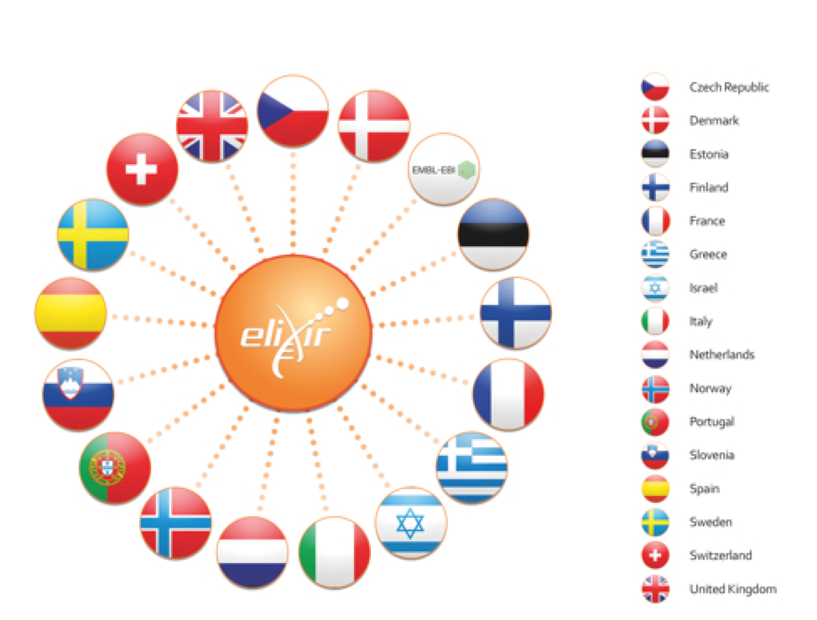
ELIXIR: European Life Science Infrastructure for Biological Information
ELIXIR was identified in 2006 as a priority by the European Strategy Forum on Research Infrasctructures (ESFRI), and under the Seventh Framework Programme, the European Commission has funded a project to promote the preparatory stages of such an infrastructure, completed at the end of 2011 , which was also participated by the National Research Council through the former Department of Life Sciences.
Juridical model of governance:
EMBL Special project
Construction process:
Memorandum of Understanding (MoU)
17 countries (Italy, July 2012)
On 18 December 2013, ELIXIR became a permanent legal entity following the ratification of the ELIXIR Consortium Agreement by EMBL and the first five countries. The countries that have signed the ECA (UK, Sweden, Switzerland, Czech republic, Estonia, Norway, Netherlands, Denmark) are full members of the ELIXIR Board.

Slide 44
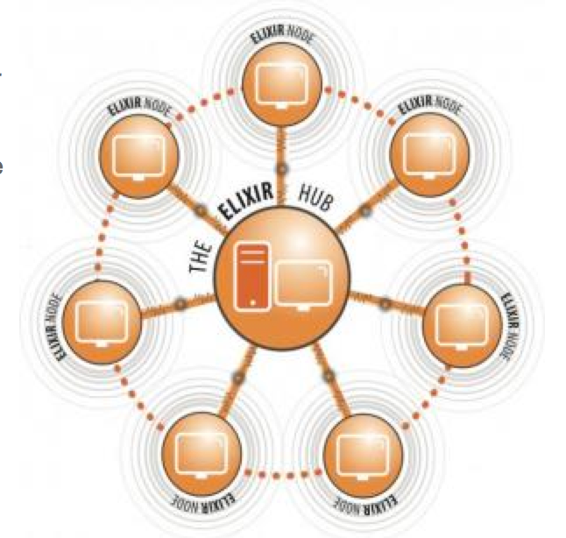
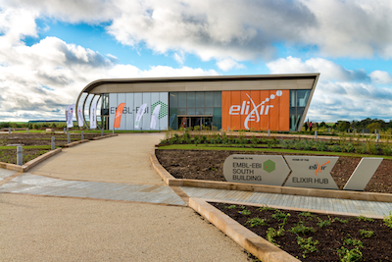
ELIXIR: European Life Science Infrastructure for Biological Information
ELIXIR will be built as a distributed infrastructure on different nodes hosted by centers of excellence located throughout Europe (the "ELIXIR nodes"); these nodes will be connected to a central hub ('ELIXIR Hub') which is located at the European Bioinformatics Institute EMBL (EMBL-EBI) in Hinxton, UK.
The ELIXIR Hub will host the Management Executive Committee and the Secretariat of ELIXIR. It will coordinate the services of the "data center" run by EMBL-EBI and the coordination of services managed by ELIXIR nodes. It will also provide the basic data (the data that is essential for almost all areas of research in the life sciences) to users.
Peripheral ELIXIR nodes will provide a range of specialized services and complementary to those provided by the central node. The integration of ELIXIR Nodes will provide essential components distributed by the ELIXIR infrastructure at European level.

Slide 45
ELIXIR: European Life Science Infrastructure for Biological Information
The ELIXIR italian node
In order to build the Italian node of ELIXIR infrastructure a Joint Research Unit has been established, coordinated by the National Research Council, which defines its scope and methods of governance, with the participation of research institutions, academic and technological as listed below:
1) Consiglio Nazionale delle Ricerche (G. Pesole, A. Facchiano, L. Milanesi)
2) Università di Roma "Sapienza” (A. Tramontano)
3) Università di Roma "Tor Vergata” (G. Cesareni)
4) Università di Milano-Bicocca (G. Mauri)
5) Università di Bologna (R. Casadio)
6) Università di Padova (G. Valle)
7) Università di Milano (G. Pavesi)
8) Università della Tuscia (A. Valentini)
9) CRS4 (G. Zanetti)
10) GARR (E. Valente)
11) CINECA (S. Bassini)
12) INFN (G. Maggi)
Università/EPR
Technological Provider

Slide 46
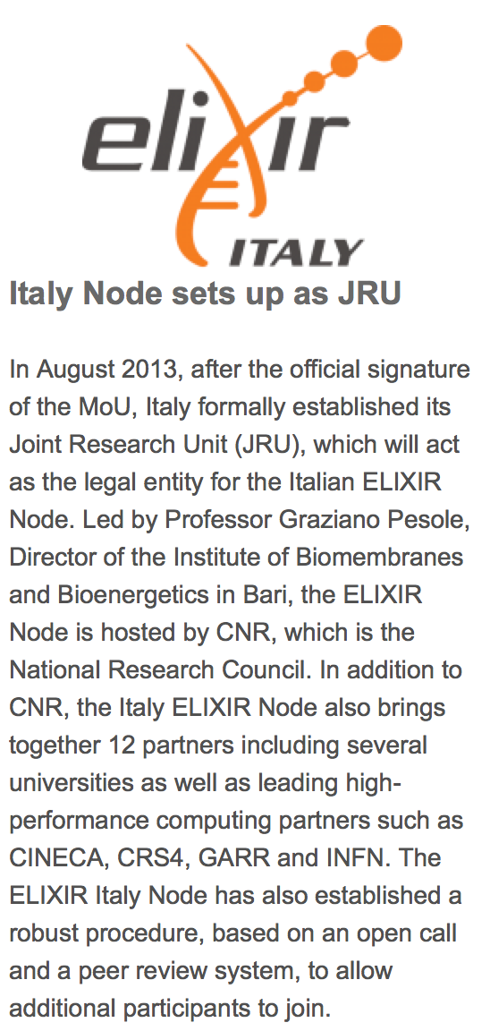
ELIXIR: European Life Science Infrastructure for Biological Information
The ELIXIR italian node
The initial nucleus of the institutions that formed the JRU includes all those who had submitted organic proposals for the involvement in ELIXIR in responding to a "call for expression of interest" in the summer of 2010. These proposals had been positively evaluated by the "Steering Committee" of ELIXIR.
Elixir-Ita Steering Committee
JRU Manager (Head of Node): Graziano Pesole
Italian delegate of Elixir Interim Board: Anna Tramontano
Elected member (Chief of Admin Affairs): Giancarlo Mauri
Elected Members:
Giorgio Valle
Sanzio Bassini

Slide 47
ELIXIR: European Life Science Infrastructure for Biological Information
Italian proposals to contribute to ELIXIR’s construction (2010)
Proposer | Description
Gianni Cesareni, Univ. Tor Vergata, Rome | Protein – protein interaction resources (MINT)
Anna Tramontano, Univ. Sapienza, Rome | Training in Bioinformatics
Giorgio Valle, University of Padua | Plant Genomics resources
Gianluigi Zanetti, CRS4, Cagliari | Human Genomics resources
Alessio Valentini, Univ. Tuscia, Viterbo | Farm Animal Genomics resources
Graziano Pesole, IBBE-CNR, Bari | Transcriptome resources and tools

Slide 48
ELIXIR: European Life Science Infrastructure for Biological Information
Italian Node Resources
Description | Web address
ASPicDB (alternative splicing patterns in the human and other genomes) | http://srv00.ibbe.cnr.it/ASPicDB/
SpliceAid-F (splicing regulatory factors and their binding sites) | http://srv00.ibbe.cnr.it/SpliceAidF/
UTRdb/UTRsite (eukaryotic mRNA untranslated regions and their regulatory elements) | http://www.ba.itb.cnr.it/UTR/
Mitozoa (database of comparative mitogenomics in metazoans | http://srv00.ibbe.cnr.it/mitozoa/
ITSoneDB (database of fungal ribosomal RNA Internal Transcribed Spacer sequences) | http://itsonedb.ba.itb.cnr.it:8080/ITS1/
DIGIT (database of immunoglobulin variable sequences) | http://biocomputing.it/digit/
MAISTAS (modeling and assessment of splicing isoforms) | http://maistas.bioinformatica.crs4.it/
MobiDB (database of protein disorder and mobile regions) | http://mobidb.bio.unipd.it/
PIGS (prediction of Immunoglobulin structures) | http://circe.med.uniroma1.it/pigs/
The grape genome browser | http://genomes.cribi.unipd.it/

Slide 49
ELIXIR: European Life Science Infrastructure for Biological Information
The italian node of Elixir: future plans
After the start-up phase, relative to the first year of operation, we plan to enhance the activities of ELIXIR-ITA, as shown below:
Strengthening of the Organizing Secretary and activation of the management bodies of the JRU.
Registry of bioinformatics resources available nationwide (databases, tools for data analysis, computational resources) that meet the requirements by Elixir.
Activation of an organic link with the Elixir hub, at the European Bioinformatics Institute (EBI), through the figure of the NTO, with the task of defining standards of operability and integration of resources.
Implementation of training activities in collaboration with EBI and other Elixir national nodes.
Coordination activities with other national initiatives of interest for the bioinformatics infrastructure (e.g. flagship national projects., etc.).
Initiation of actions for the creation of a distributed National Institute of Bioinformatics.

Slide 50
ELIXIR-ITA:Technological Partners
Setting up a bioinformatics computational infrastructure (cloud-based) interconnected with ELIXIR Europe

